Slide 1

Project 3
Classifying Real and Fake News

Slide 2
Content
Intro / Background / Problem Statement
Data Collection
Data Cleaning and EDA
Preprocessing and Modelling
LOGISTIC REGRESSION
NAIVE BAYES
Evaluation + Insights
Conclusion, Limitations and Future Outlook

Slide 3


Real or Fake? Can you tell?

Slide 4

Real vs Fake? How can we tell the difference?

Slide 5
Problem Statement
The increasing popularity and reliance on social media as a source of information worsens the problem of misinformation (fake news) today.
As a team of data scientist hired by a US government agency, we aim to analyse and detect fake news using Natural Language Processing (NLP) using data from the News and The Onion subreddit threads.
Notes:
“Misinformation is a virus unto itself.”
― Brianna Keilar

Slide 6
Why is fake news dangerous?
Many people cannot tell the difference between real and fake news
Creates confusion and misunderstanding about important socio-political issues
Cascades down to cause more dangerous widespread effects
Trump: used social media to spread misinformation and divide the people
Covid-19: Ivermectin as a cure

Slide 7

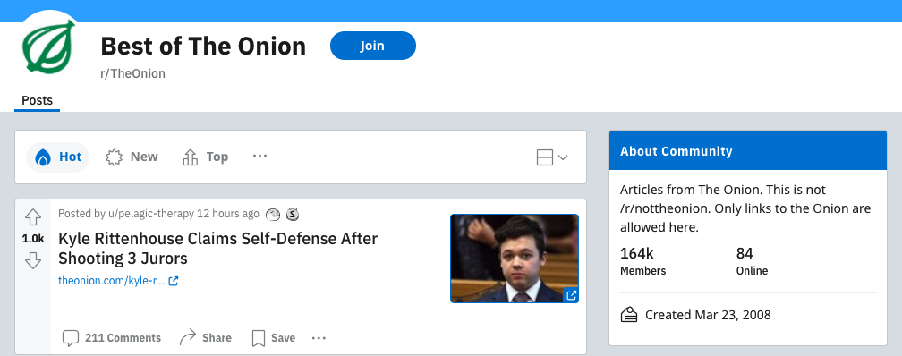
Background
News articles current affairs in the US and the world
Satirical, fake news

Slide 8
Data Collection
Using PushShift API
PushShift allows for only 100 posts each retrieval
Created a loop to retrieve posts from the subreddits since
Set a sleep timer between loops so we wouldn’t get blocked
Retrieved 10,000 posts from each subreddit
Filter through to obtain posts not removed by moderators
‘removed_by_category’: ‘Nan’
Posts were retrieved backwards from 25th Oct 2021
UTC: 1635120000

Slide 9
Data Cleaning
دانلود آهنگ کردی گیس چنریا از ساسان ملکی
Volcán Monte Aso entra en erupción en Japón
Remove rows that aren’t in English
> 2 non-alphanumeric characters
Notes:
After we scraped the 10,000 rows of data, we had a large number of spam submissions that needed to be cleaned out of the dataset. We first started by cleaning out submissions that weren't in English, which we identified as submissions with titles that have a high number of non-alphanumeric characters.

Slide 10
Data Cleaning
دانلود آهنگ کردی گیس چنریا از ساسان ملکی
Volcán Monte Aso entra en erupción en Japón
Remove rows that aren’t in English
> 2 non-alphanumeric characters
https://edition.cnn.com/2021/09/16/us/florida....
Remove rows with links
anything containing “http”
Notes:
Then, we removed titles with links in them by searching for titles that contained the substring "http".

Slide 11
Data Cleaning
دانلود آهنگ کردی گیس چنریا از ساسان ملکی
Volcán Monte Aso entra en erupción en Japón
Remove rows that aren’t in English
> 2 non-alphanumeric characters
https://edition.cnn.com/2021/09/16/us/florida....
Remove rows with links
anything containing “http”
test Ouch. onion ice
Remove outliers in terms of length
< 5 words in length
Notes:
After that, we removed rows with extremely short titles. We saw submissions in the dataset named with titles like "test", "Ouch", and "onion ice", all which appeared to be spam.

Slide 12
Data Cleaning
دانلود آهنگ کردی گیس چنریا از ساسان ملکی
Volcán Monte Aso entra en erupción en Japón
Remove rows that aren’t in English
> 2 non-alphanumeric characters
https://edition.cnn.com/2021/09/16/us/florida....
Remove rows with links
anything containing “http”
test Ouch. onion ice
Remove outliers in terms of length
< 5 words in length
Remove duplicate headlines
✔
r/news 9336
r/TheOnion 8872
Notes:
Finally, we removed all duplicate headlines, leaving only unique values. We were left with 9300 real news headlines, and 8800 fake news headlines.

Slide 13
Data Cleaning
I am a happy person. I am filled with happiness. 我很快乐!
Remove punctuation and non-alphanumeric characters
I am a happy person I am filled with happiness
Tokenize
I, am, a, happy, person, I, am, filled, with, happiness.
Remove stop words
happy, person, filled, happiness
Lemmatizing
happy, person, fill
Notes:
After cleaning out the spam submissions, we processed the remaining headlines by…... removing punctuations and non-alphanumeric characters…... tokenizing the words to get the individual words...... removing stop words like "I" "am" or "with" that contributes little meaning to the headline...... and then finally, we lemmatized the headlines to get the root words. This readied our data to go through the count vectorizers.

Slide 14
Exploratory Data Analysis
1
Hour of Posting
2
Length of Headline
3
Number of Comments
4
Month and Year of Posting
5
Headline
Notes:
We collected 5 features: the hour the headline was submitted, the length of the headline, the number of comments posted on the headline, the month and year in which the headline was submitted-- We’ll look through these four first before we start analyzing the headlines.

Slide 15
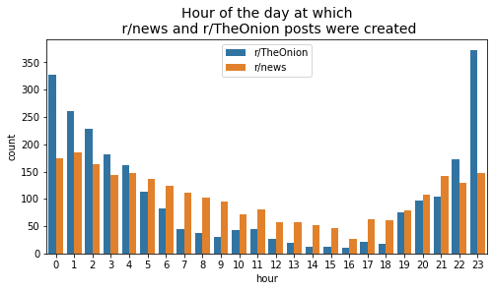
Time of posts
Notes:
First, from the time the headlines were posted, it appears that members of the two subreddits were active at vastly different times of the day.

Slide 16
Time of posts
Between 10PM - 4AM is when the bulk of r/TheOnion posts are made.
Notes:
The Onion headlines were mostly submitted at night till the wee hours of the morning, between 8pm to 2am. You can see in these two circles that there were more The Onion headlines posted between 10PM to 4AM...

Slide 17
Time of posts
Between 10PM - 4AM is when the bulk of r/TheOnion posts are made.
Between 5AM - 9PM, the volume of r/news posts overtake r/TheOnion
Notes:
…before the volume of r/news submissions begins to overtake The Onion submissions during the day, between 5AM to 9PM.

Slide 18
Time of posts
Between 10PM - 4AM is when the bulk of r/TheOnion posts are made.
Between 5AM - 9PM, the volume of r/news posts overtake r/TheOnion
Posts on r/news were created more consistently through the day
Notes:
From this chart, we can clearly see that r/news headlines were submitted more consistently throughout the day, while The Onion headlines tend to be submitted at night.

Slide 19
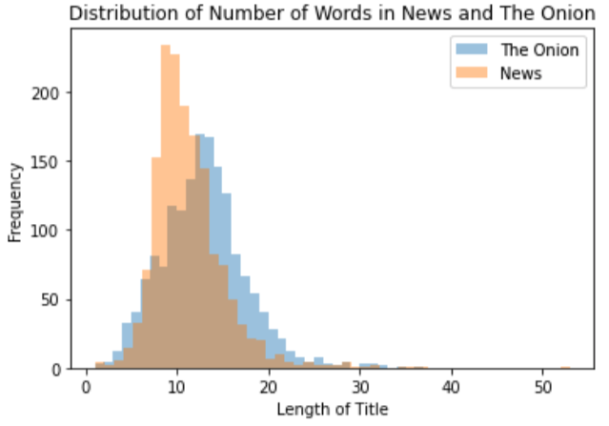
Title length and Number of comments
Distribution has a right skew, r/news titles tend to have less words than r/TheOnion
Notes:
Second, for the length of the headlines, we can see that headlines in both subreddits generally skewed towards the shorter end, but r/news headlines tended to be shorter than The Onion headlines. However, there wasn’t a very significant difference between the two...

Slide 20
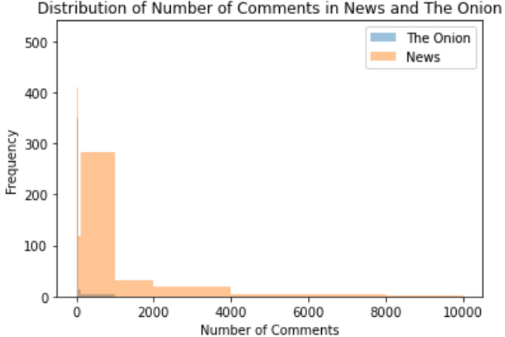
Title length and Number of comments
Distribution has a right skew, r/news titles tend to have less words than r/TheOnion
Posts from r/news generally receive more comments than posts from r/TheOnion
Notes:
… On the other hand, there was a pretty large difference in the number of comments received on headlines across both subreddits. Submissions to The Onion subreddit received only a fraction of the comments that submissions to the news subreddit did. In general, it can be seen that the news subreddit is much more active than The Onion subreddit.

Slide 21
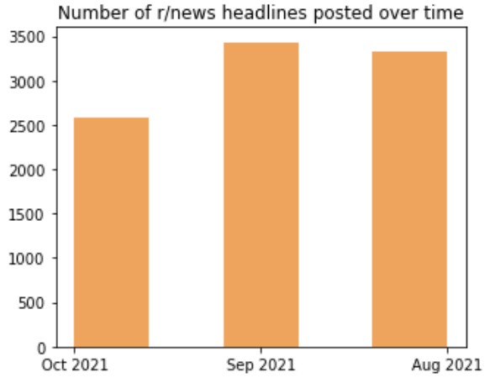
Month and year of posts
The r/news headlines were all created in the last three months from August to October
Notes:
This may explain the discrepancies in month and year of headlines in the dataset. Likely due to an extremely high volume of headlines being submitted to r/news, all of the 10,000 rows that were scraped from r/news were submitted in the last three months.

Slide 22
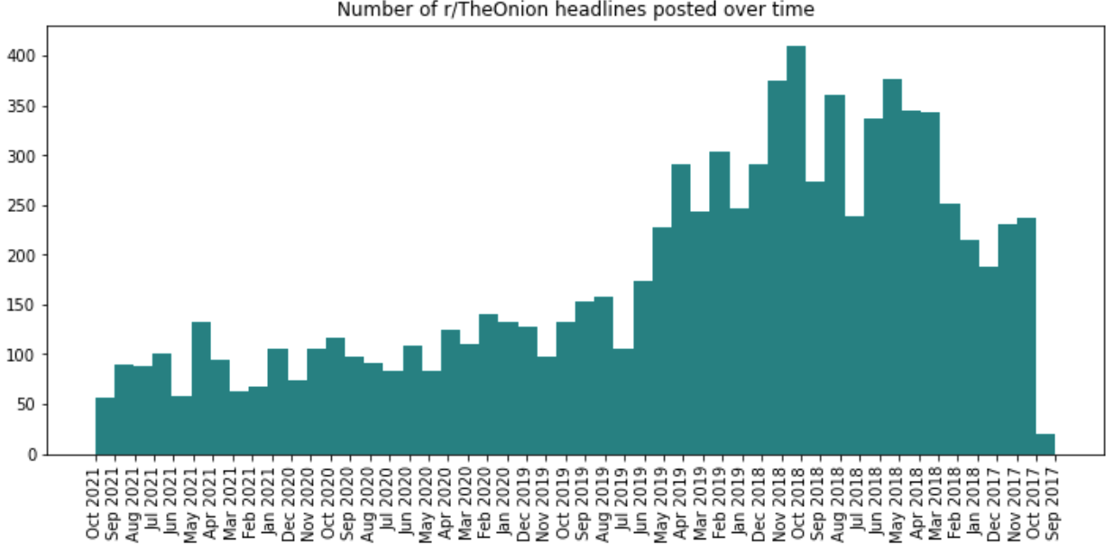
Month and year of posts
The r/news headlines were all created in the last three months from August to October
r/TheOnion headlines spanned back to 2017
Notes:
In comparison, due to a lower volume of submissions. We crawled four years of data in order to scrape the 10,000 headlines from The Onion subreddit. The headlines spanned all the way back to 2017. My groupmates will later talk more about the impact of the imbalanced dataset on our model, but for now, let’s move on to the headlines. Which is the most interesting part!

Slide 23
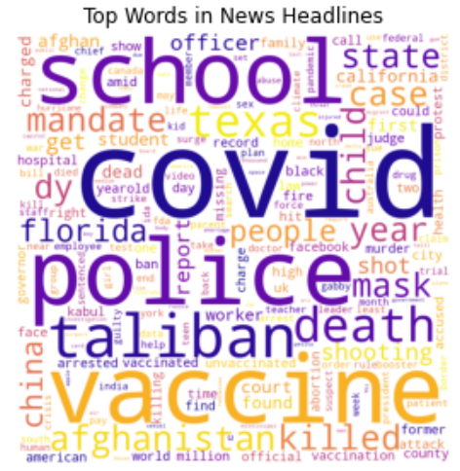
Top words in r/news
Notes:
Right away, we can see that there were several topics that seemed to dominate r/news headlines.

Slide 24
Top words in r/news
Pandemic
Notes:
The global pandemic, vaccines, and masking was a hot topic in r/news.

Slide 25
Top words in r/news
Pandemic
Violent crimes
Notes:
There was also many headlines about violent crimes, which included reports of people being killed or shot. The high incident of words like police along with shootings may also be due to reporting of police brutality in light of the Black Lives Matter movement, and school shootings as well.

Slide 26
Top words in r/news
Pandemic
Violent crimes
Recent politics news
Notes:
Finally, r/news headlines also covered recent political events like the Taliban’s takeover of Afghanistan. As can be seen, these are all relatively recent events as the headlines were all posted in the last three months.

Slide 27
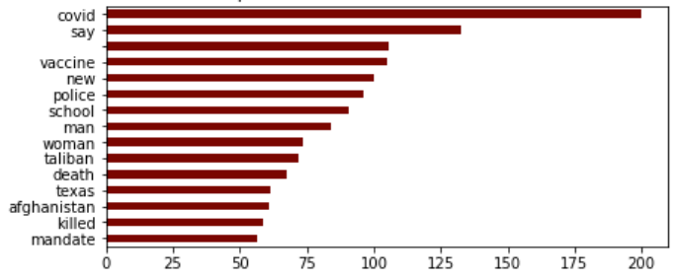
Top words in r/news
Pandemic
Violent crimes
Humanitarian crises
Notes:
Anyway, it’s been a pretty hectic time recently, so the top words seen in r/news headlines generally look quite grim.

Slide 28
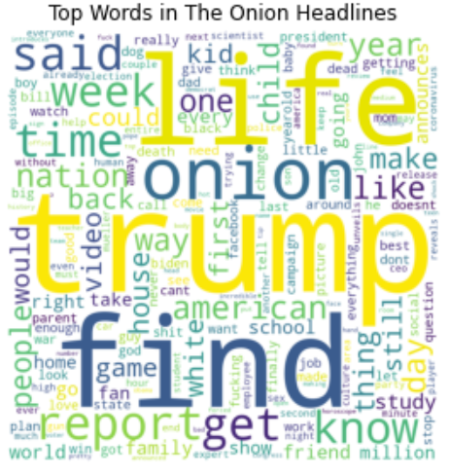
Top words in r/TheOnion
Use of more general words
Notes:
In comparison, top words in The Onion headlines were more light-hearted and general, as seen by heavy incidence of words like “life” “find” “child” “week” and “kid”

Slide 29
Top words in r/TheOnion
Use of more general words
(Except for Trump)
Notes:
Except for Trump, which is pretty specific.

Slide 30
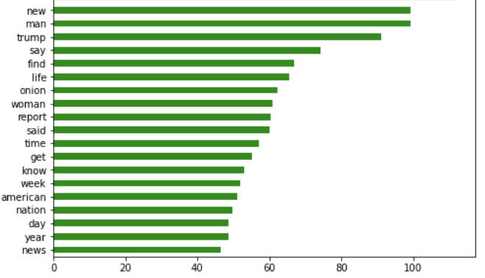
Top words in r/TheOnion
Use of more general words
(Except for Trump)
Notes:
Anyway, the list of top words here are clearly more general and more lighthearted in nature, which may on one hand reflect the humorous direction of The Onion. On the other, it may simply be because the headlines in this dataset stretched back all the way to 2017. News on the pandemic or more recent political events are thus likely to be underrepresented in this dataset. Trump may be an exception because he assumed his presidency in 2017, and that lasted four years until only recently. My groupmates will talk more about the impacts of the imbalanced headlines on our models later on. Haziq will now cover the modelling.

Slide 31
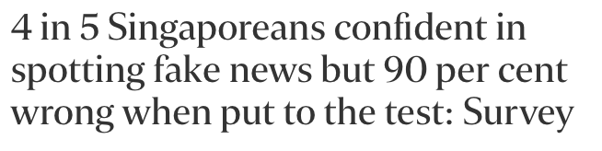
Preprocessing and Modeling - Overview
Human Baseline Model: 10% accuracy
Notes:
90 per cent of Singaporeans did not spot fake news correctly eventhought 80% were confident of doing so source. This proves that the human mind is alot more subjective when interpreting news, and therefore the used of machines to learn the intricacies of words in news can be helpful. 53% of American adults read the news on social media.

Slide 32
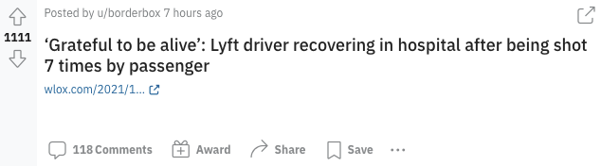
Preprocessing and Modeling - Overview
Detecting fake news (2 approaches)
Non-text features
Score
Comments
Length of post
Time
Text features
Headline text
Notes:
As mentioned earlier our goal is to detect fake news form subreddits posts.
And we do so with 2 approaches.
We wanted to give different perspectives to our audience, and therefore we created 2 machine learning models
One utilizing the information from a post that is not directly related to the content such as (like time created, number of words, score, etc)
Two, utilizing Natural Langauge Processing that directly targets the text within the post itself.

Slide 33
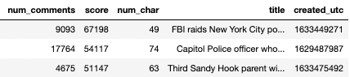
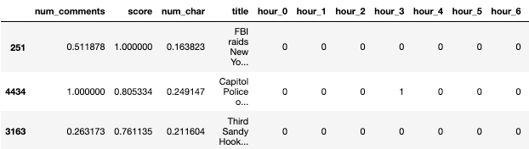
Preprocessing and Modeling - Non-text features
Preprocessing:
One-hot encoded `hours` from time (epoch)
Scaling of data
Notes:
Preprocessing for REddit posts features:
We first converted the time from epoch format to proper time format
We then one hot encoded hours
As seen earlier from rebecca’s explanation, we could see that there were obvious correlations between hour of post and the subreddit, hence we decided to keep these features
We also scaled our data as posts can receive comments up top 10000s.
Features that best discerns a post:
Number of comments
Score
Number of characters in a post
Posts created in the middle of the month

Slide 34
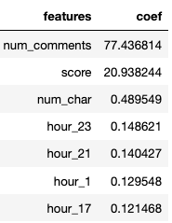
Preprocessing and Modeling - Non-text features
Modeling:
Logistic Regression
K-Nearest Neighbors
Naive Bayes
Hyperparameter tuning thru GridSearchCV
Best model: Logistic Regression
 | Train Accuracy | Test Accuracy
Before hyperparameter tuning | 0.8445 | 0.852
After hyperparameter tuning | 0.906 | 0.904
Notes:
After gridsearchCV hyperparameter tuning:
C= 20, l1_ratio= 0.25, solver= 'newton-cg'
And here we have the coefficient values of the top features that helps the model distinguoish between fake and real news. Interestingly, while the coeff values are low, we can see that the late hours are when posts from theonion are generated.

Slide 35
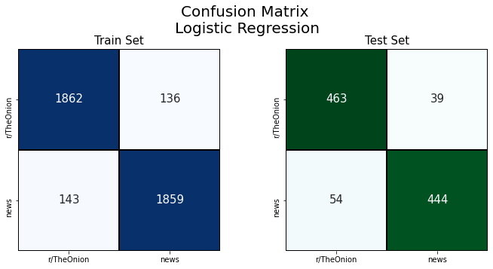
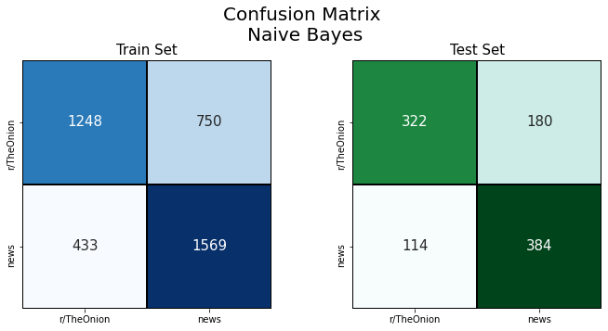
Comparison (Non-text features)
Logistic Regression
463 assigned as fake
90%
517 fake news
54 assigned as real
Naive Bayes
322 assigned as fake
74%
436 fake news
114 assigned as real
Notes:
So with fake news, what we want to do is to focus on the number of fake news itself:
We want to maxmise the number of fake news which we predicted as fake
And we want to minimize the number of fake news which we predicted as real
So keep this in mind as we go thru the results; we want to maximise the number on the top left, and minimizse the number of the bottom left
We want our model to:
correctly assigns fake news as fake
Minimise wrongly assigns fake news as real\
Logistic Regression:
Out of 517 fake news, 54 was wrongly deemed as real (10%)
Naive Bayes
Out of 436 fake news, 114 was wrongly deemed as real (26%)

Slide 36
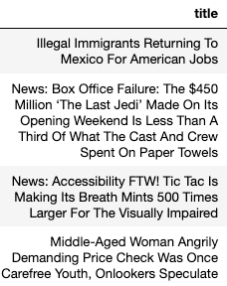
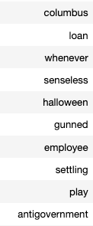
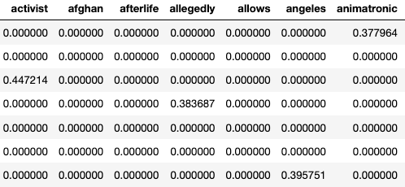
Preprocessing and Modeling - Text features (NLP)
Preprocessing:
Conversion of textual data into vectorized forms:
Count Vectorizer (1, 3)
TF-IDF Vectorizer (1, 3)
Notes:
We received the headlines from reddit
We tokenized into idnvidiual words
We assign vectorized values

Slide 37
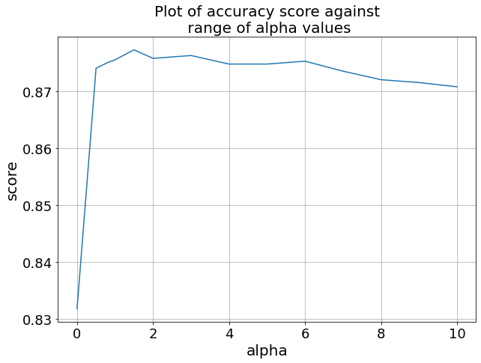
Preprocessing and Modeling - Text features (NLP)
Modeling:
Logistic Regression
K-Nearest Neighbors
Naive Bayes
Hyperparameter tuning thru GridSearchCV
Optimized alpha value of 1.5
Alpha = 1.5
Best model: Multinomial Naive Bayes (TFIDF)
 | Train Accuracy | Test Accuracy
Before hyperparameter tuning | 0.875 | 0.829
After hyperparameter tuning | 0.877 | 0.904
Notes:
We utilized a pipeline to run our models with difference combinations of Vectorization, models, and hyperparameters
MultinomialNB: 0.878
With best parameters: {'clf': MultinomialNB(alpha=1.5), 'clf__alpha': 1.5}
What is alpha?
Also know as laplace smoothing
Naive bayes works on the basis of probability of words appearing in a sentence.
Therefore, if a word is not found in that sentence, Naive Bayes assigns a probability of 0 in that node, which is not entirely true, because we cannot say for sure that the word will not be found in that node.
For e.g. if the word “covid” did not appear in any of the subreddit r/TheOnion, Naive Bayes would assign prob =0 if alpha =0. However this is not the case because we cannot say there is 0 prob of the word covid appearing in TheOnion subreddit just based on our sample. By default, Naive Bayes assigns alpha = 1, however with hyperparamet tuning, we found that alpha = 1.5 gives optimal score.
Therefore we assign a “cushion” value which is the alpha value. Alpha = 1.5 sounds about right since, considering that we have 5000 documents.
Alpha is the amount of cushion or padding we give to words that are not in sentence

Slide 38
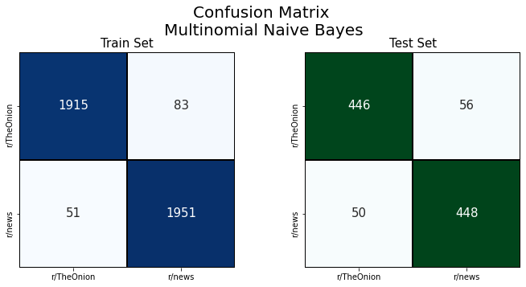

Comparison (Text features)
Naive Bayes
446 assigned as fake
90%
496 fake news
50 assigned as real
Logistic Regression
461 assigned as fake
87%
532 fake news
71 assigned as real
Notes:
Multinomial Naive Bayes selected over Logistic Regression
More even distribution of FP and FN
Less overfitting

Slide 39
Evaluation: Modeling for Non-Text Features
 | Logistic Regression | Naive Bayes Multinomial | K-Nearest Neighbour
Train Accuracy | 0.930 | 0.704 | 0.857
Mean CV Accuracy | 0.918 | 0.693 | 0.725
Test Accuracy | 0.907 | 0.706 | 0.743
Precision | 0.919 | 0.681 | 0.722
Recall | 0.892 | 0.771 | 0.787
F1-Score | 0.905 | 0.723 | 0.753
Precision = True Positive / (True Positive + False Positive)

Slide 40
Evaluation: Modeling for Text Features
 | Logistic Regression | Naive Bayes Multinomial | K-nearest neighbour
Train Accuracy | 0.995 | 0.967 | 0.865
Mean CV Accuracy | 0.876 | 0.877 | 0.774
Test Accuracy | 0.888 | 0.894 | 0.78
Precision | 0.905 | 0.889 | 0.713
Recall | 0.865 | 0.90 | 0.933
F1-Score | 0.885 | 0.894 | 0.809

Slide 41
Evaluation: Combining both models
What have we done so far and why?
Data Retrieval
Correct prediction of real news by Log Reg (Non-text data): | 91.9%
Correct prediction of real news by Naive Bayes (Text data): | 89%
Correct prediction by consensus result : | 97.8%
Non-Text Data
Text Data
Data Cleaning
Data Cleaning + NLP + CV / TI-IDF
Logistic Regression
Naive Bayes Multinomial
Consensus Result

Slide 42
Extra explanation of consensus result
CONFUSION CUBE (C-SQUARED)
Model Results Confusion Matrix
LogReg Predict Fake
 | Predicted News | Predicted Fake
Actual News | TP | FN
Actual Fake | FP | TN
LogReg Predict News
Super
True
Positive
Actual
News
Super
True
Negative
Prob that a post is real given both models predicted it as real news = 0.978
Prob that a post is fake given both models predicted it as fake = 0.988
Actual
Fake
Naive Bayes Predict News
Naive Bayes Predict Fake
Notes:
Total number of LR and NB that predicted actual news = 406
Total number of LR and NB that predicted real news that is actually real = 397
Total number LR and NB predicted fake news = 422
Total number of LR and NB that predicted fake news that is actually fake = 417

Slide 43

Evaluation: Illustration of both models in practice
An illustration
Sri Lanka replaces health minister said to promote shaman’s herbal syrup as a Covid remedy
REAL NEWS
FAKE NEWS
Notes:
An illustration of using both models to predict if a subreddit post is real or fake

Slide 44
Evaluation: Illustration of both models in practice
An illustration
Sri Lanka replaces health minister said to promote shaman’s herbal syrup as a Covid remedy
Logistic Regression using non-text features: REAL NEWS
Naive Bayes using Subreddit title (text) features: REAL NEWS
REAL NEWS
FAKE NEWS
Notes:
An illustration of using both models to predict if a subreddit post is real or fake

Slide 45
Evaluation: Illustration of both models in practice
An illustration
Sri Lanka replaces health minister said to promote shaman’s herbal syrup as a Covid remedy
Logistic Regression using non-text features: REAL NEWS
REAL
Naive Bayes using Subreddit title (text) features: REAL NEWS
REAL NEWS
FAKE NEWS
Notes:
An illustration of using both models to predict if a subreddit post is real or fake

Slide 46
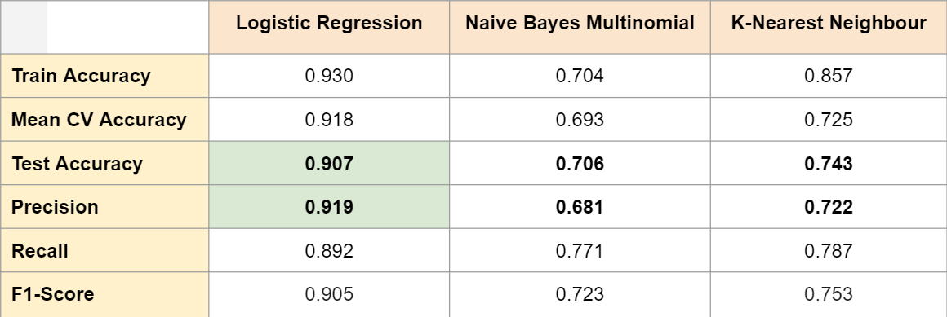
Conclusion
When non-text data is used, such as time the post was created, post score and number of comments, Logistic Regression far outperforms the rest of the models.
Notes:
1

Slide 47
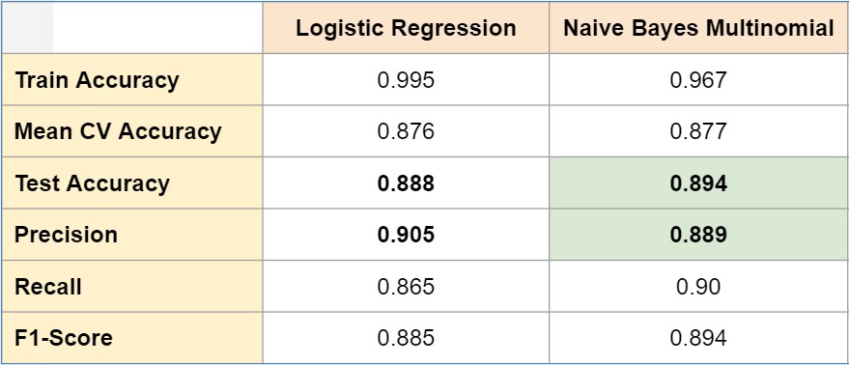
Conclusion
Both Logistic Regression and Naive Bayes perform quite similarly when classifying text.
Notes:
2

Slide 48
Recommendations
It was interesting to note that Logistic Regression on non-text features had better scores overall when predicting whether a title was legit or not.
Notes:
2.5

Slide 49
Recommendations
It was interesting to note that Logistic Regression on non-text features had better scores overall when predicting whether a title was legit or not.
However;
Our group recommends the textual count vectorized Naive Bayes model.
Notes:
2.75

Slide 50
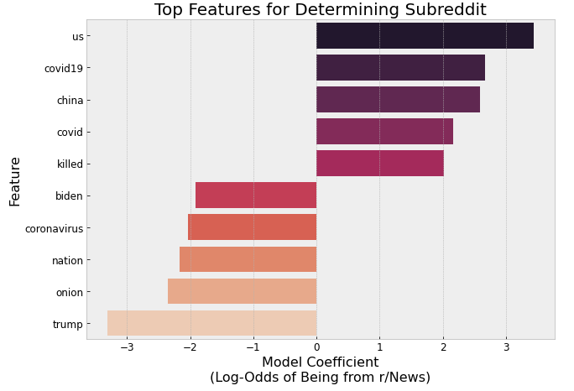
Limitations
Notes:
3

Slide 51
Misclassified r/TheOnion posts
D.C Police Preemptively Deploy 3 Officers For Inauguration Day
Covid Denier Struggling To Protest State’s Incoherent, Constantly Changing Coronavirus Policies
Unvaccinated Mom Wants To Know If You’re Coming Home For Covid This Year
U.N. Court Orders U.S. To Ease Sanctions Against Iran
Notes:
4

Slide 52



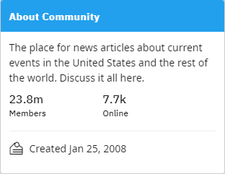
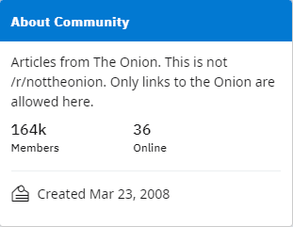
Subreddit Members
Notes:
5

Slide 53
Limitations
Notes:
6

Slide 54
Limitations
The r/news headlines were all created in the last three months from August to October
r/TheOnion headlines spanned back to 2017
Notes:
7

Slide 55
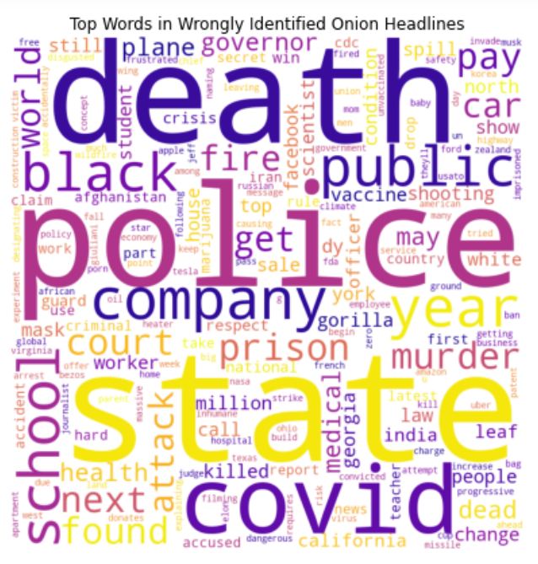
Notes:
8

Slide 56
Notes:
9

Slide 57
Notes:
10

Slide 58
Notes:
11

Slide 59
Notes:
12

Slide 60
Future Outlook
Compare date and headline keywords.
Notes:
13

Slide 61
Future Outlook
Compare date and headline keywords.
Look into other legit news sources to see if the model is able to pull its weight on different headlines from other places.
Notes:
14

Slide 62
Future Outlook
Compare date and headline keywords.
Look into other legit news sources to see if the model is able to pull its weight on different headlines from other places.
Apply models to r/NotTheOnion. (real news that sounds like fake news)
Notes:
15

Slide 63
Future Outlook
Compare date and headline keywords.
Look into other legit news sources to see if the model is able to pull its weight on different headlines from other places.
Apply models to r/NotTheOnion. (real news that sounds like fake news)
Perform sentiment analysis.
Notes:
16

Slide 64
Thank you!
Any Questions?

